Slide 1

Sales Strategy

Slide 2



R&D Project Updates
DX-145 Drone release scheduled in Q1
DX-145-R receiver scheduled to release in Q1
RTE-QFN20 delayed to increased materials demand – Q2 release

Slide 3
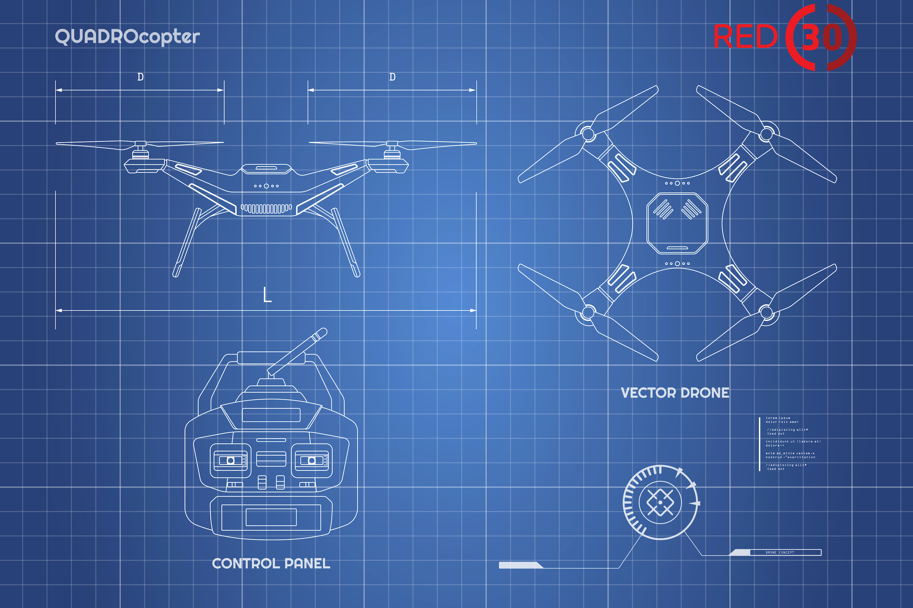

Slide 4


Slide 5

Project Orange STEM

Slide 6


Slide 7
Conference Agenda
9:00 AM – 10:00 AM
Breakfast
10:00 AM – 11:00 AM
Keynote speaker
11:15 AM – 12:00 PM
Breakout sessions
12:00 PM – 1:00 PM
Lunch
1:00 PM – 1:45 PM
Breakout sessions
1:45 PM – 2:00 PM
Coffee break
2:00 PM – 2:45 PM
Breakout sessions
3:00 PM – 4:00 PM
Closing speaker

Slide 8
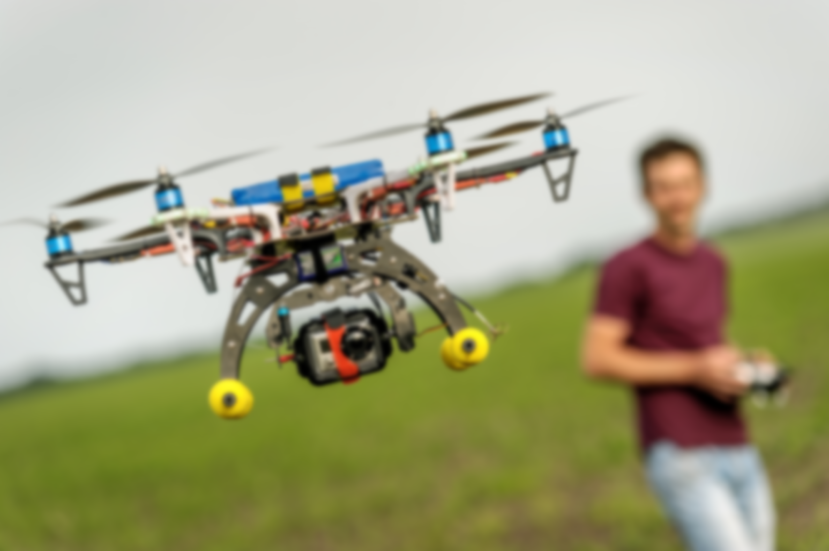
By 2022, 1 in 4 households will own a drone.

Slide 9


Slide 10


Slide 11
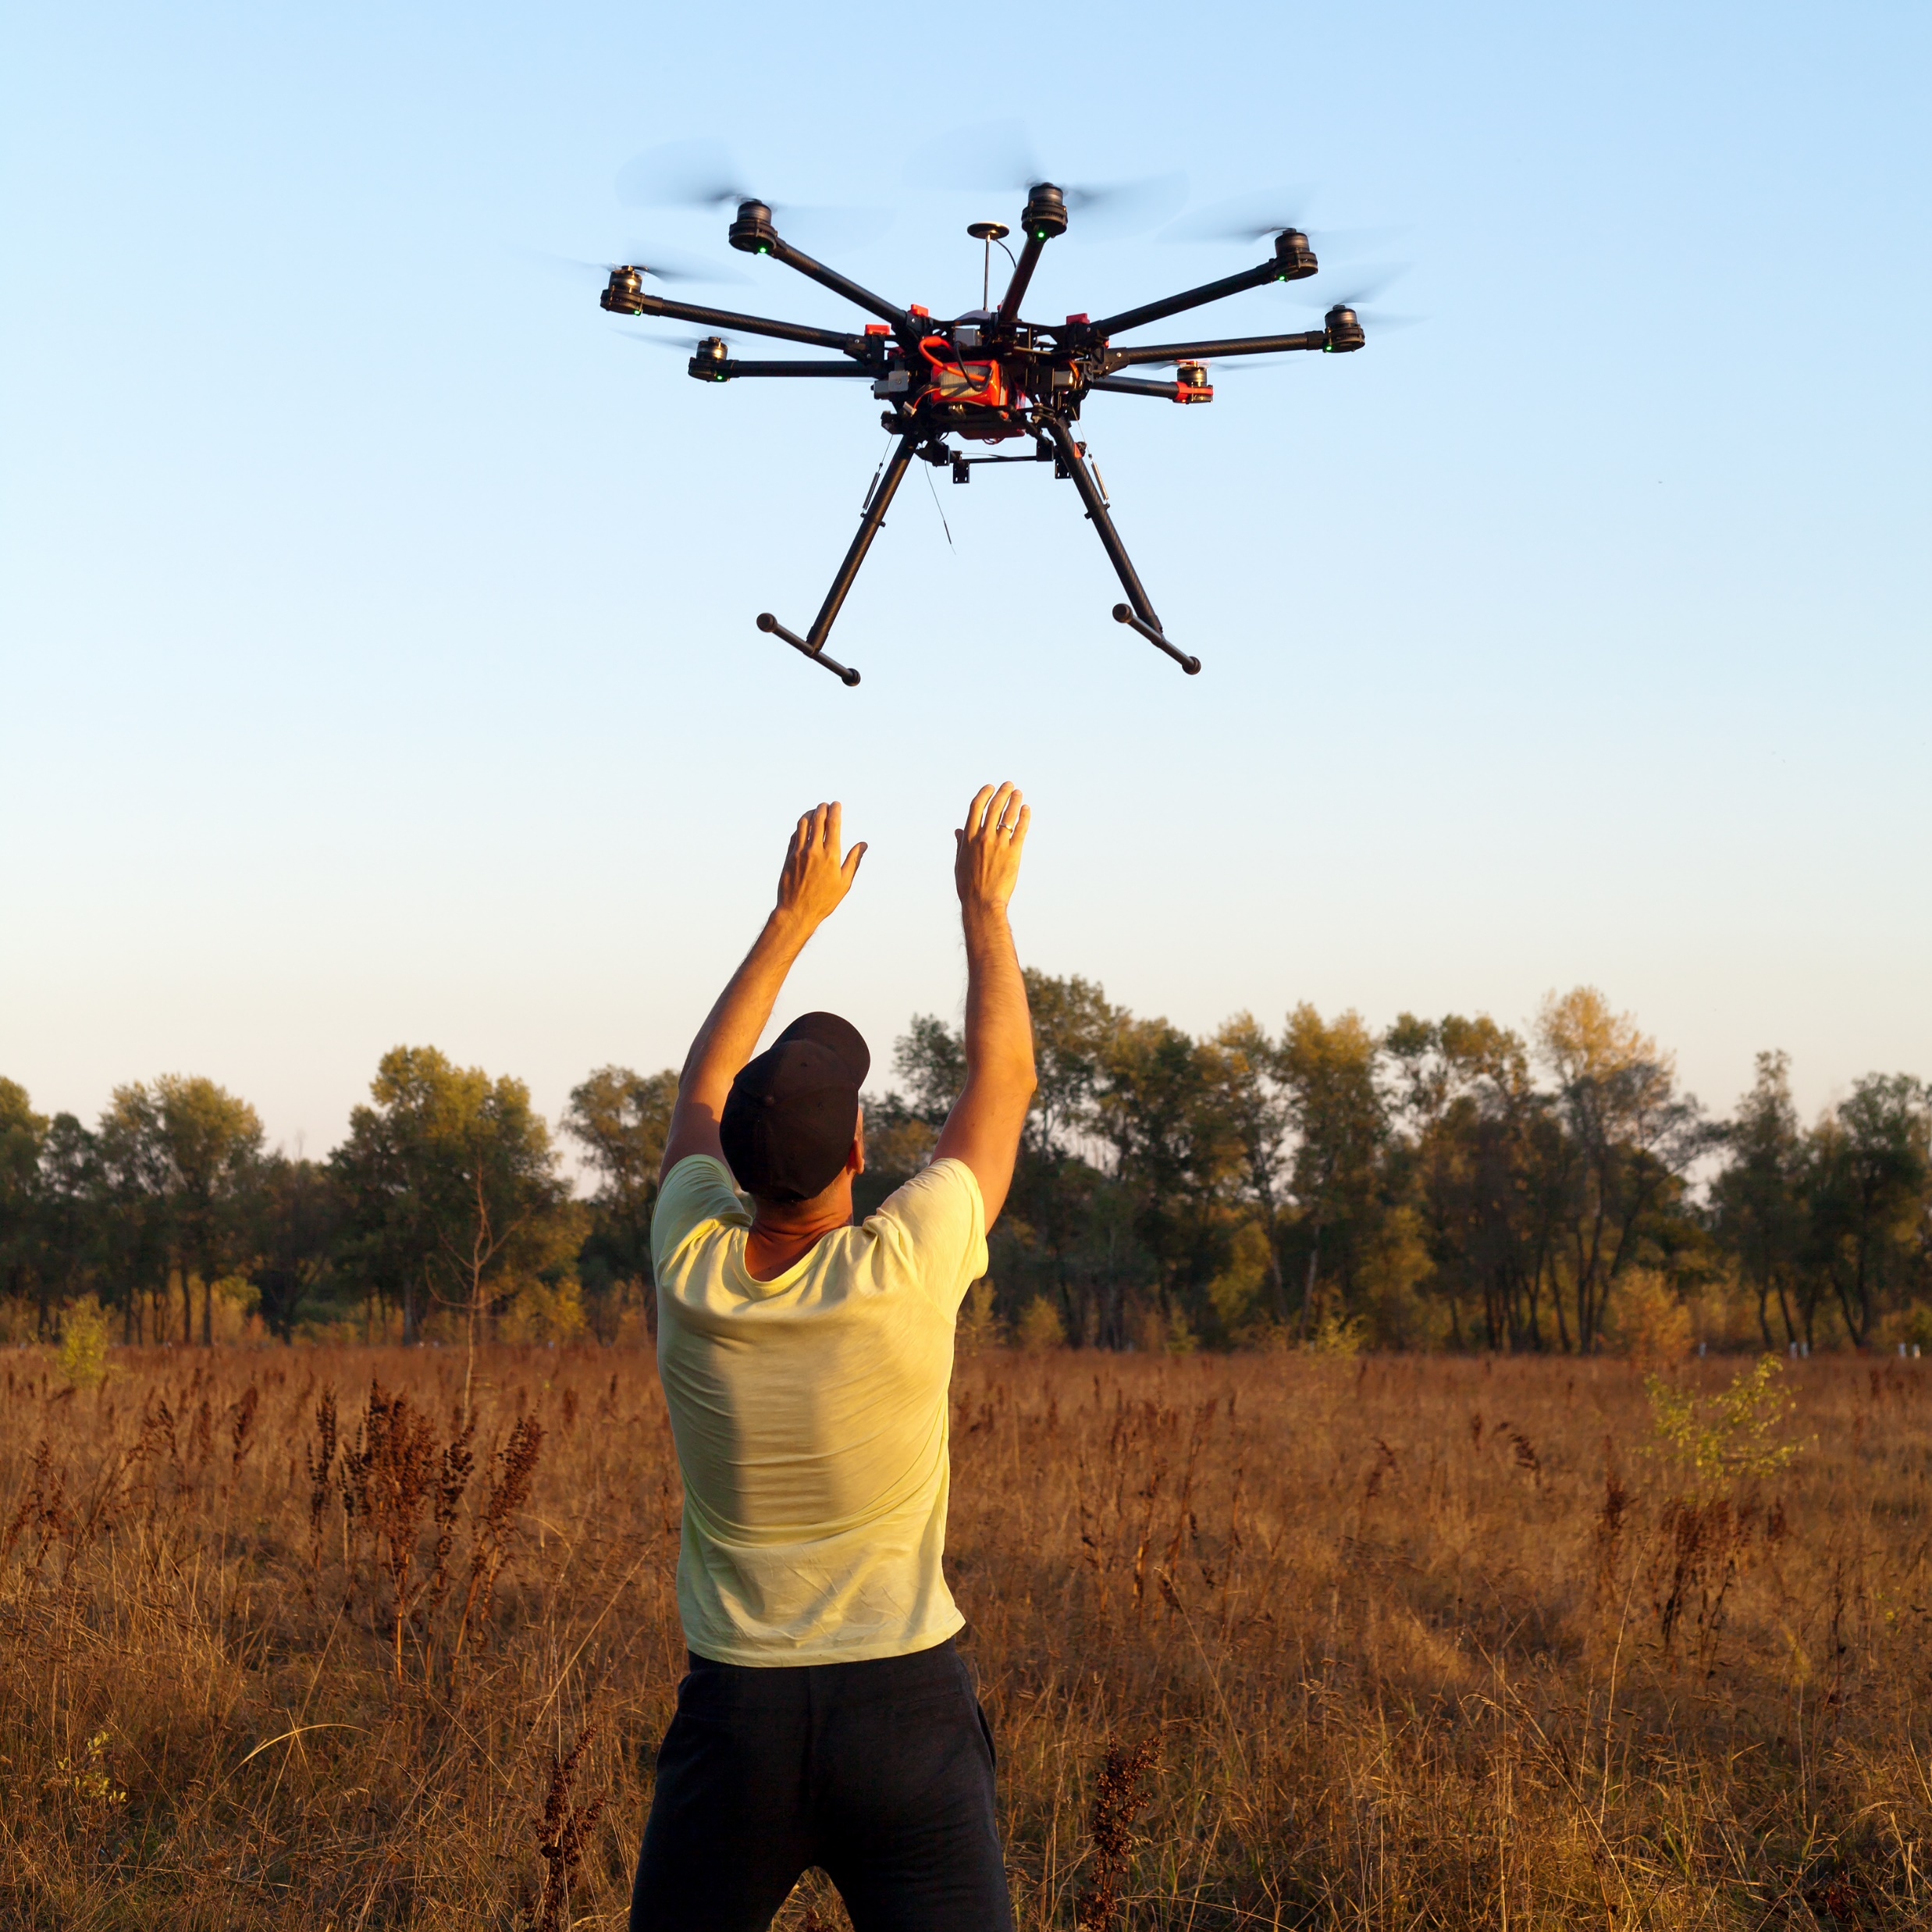
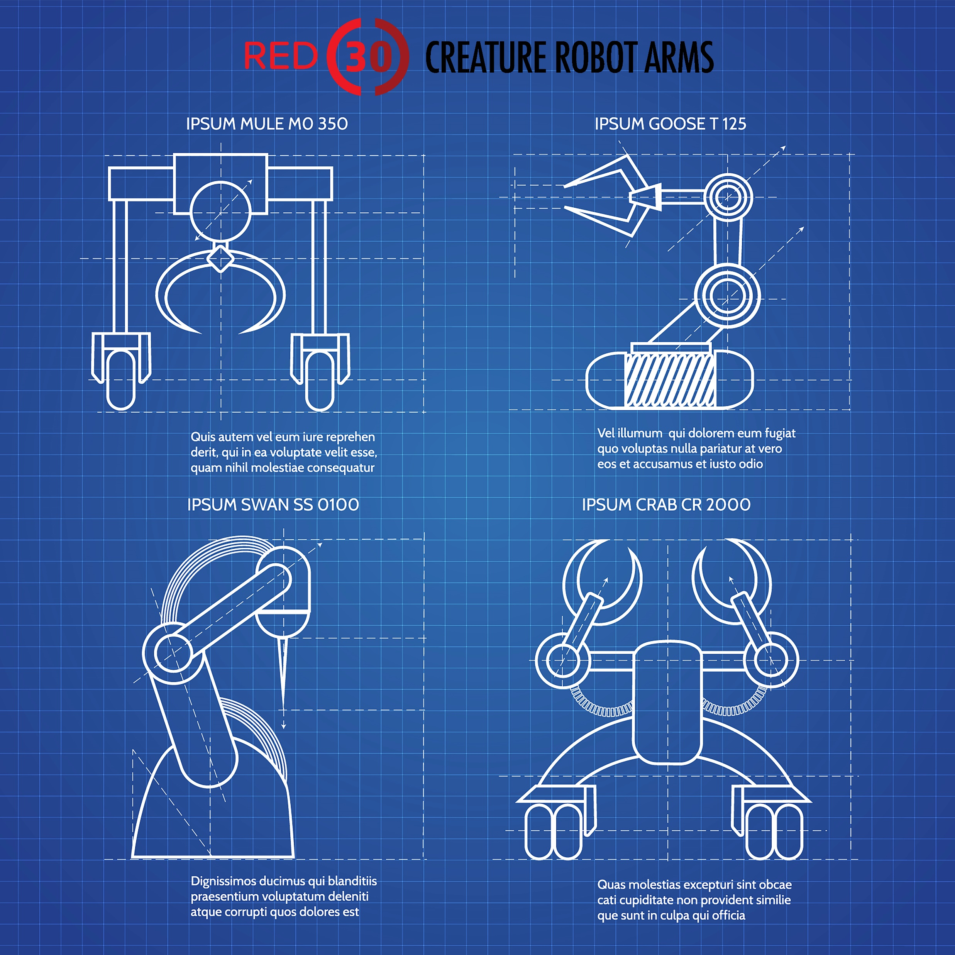

Slide 12


Slide 16
Strategic Opportunities
Opportunity
  Plan
Exploration
  Reach
Decision Making
  Act
Purchase
  Convert

