Slide 1
Aspen Falls Lifestyle
Presented by Maria Martinez, City Supervisor

Slide 2
Aspen Falls
Durango County, California
Blends rural atmosphere, urban amenities and opportunities
Aspen Falls aspires to promote a healthy lifestyle

Slide 3
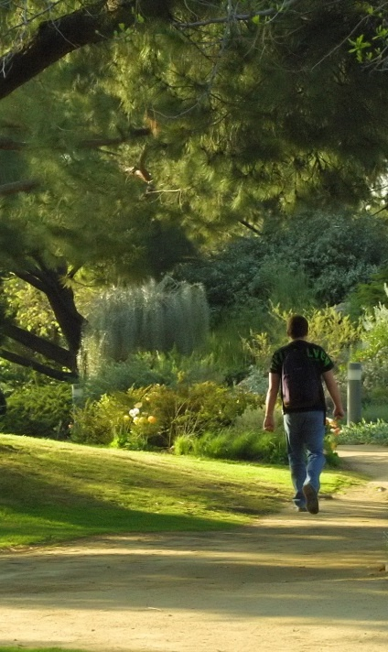
Aspen Falls Lifestyle
Citizen wellness
Recycling and reusing
Water conservation and alternative energy
Pedestrian friendly neighborhoods

Slide 4
Aspen Falls Events
Winter Blues Festival
Annual Wine Festival
Cinco de Mayo
Vintage Car Show
Harvest Days
Amateur Bike Races
Farmers’ Market
Aspen Falls Triathalon

Slide 5
Our Mission
It is the misson of the City of Aspen Falls to maintain an environment dedicated to the security of our residents and to foster growth and developement of community.
Responsible, sustainable growth
Citizen involvment

Slide 6
Aspen Falls
Durango County, California
Maria Martinez, City Supervisor

Slide 7
Upcoming Town Hall Style Meetings

Slide 8
Upcoming Events

