Slide 1
Introduction: Databases
By Margaret Lion

Slide 2

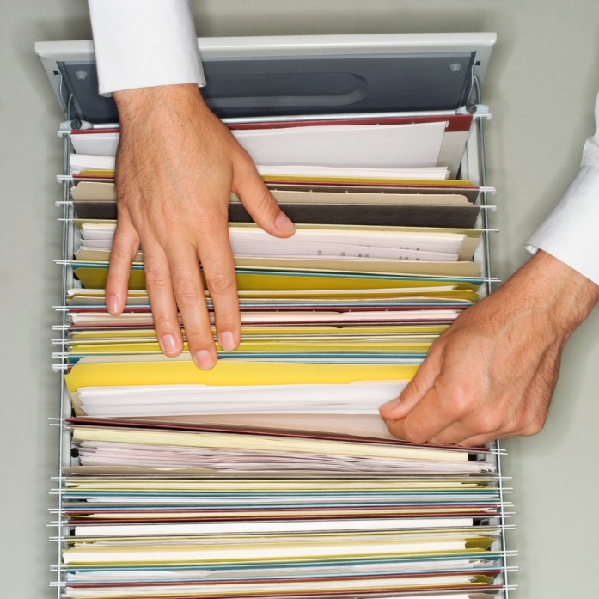

What is a database?
A collection of data organized to serve many applications efficiently by centralizing the data and minimizing redundant data.

Slide 3
Some definitions
Data – raw facts about people, events, things or ideas
Database – a collection of related data
Information – data organized in a useful manner
Table – data organized in columns (called fields) and row (called records)

Slide 4
Access Objects
Access database has several objects. We will use these four:
  Tables
  Forms
  Queries
  Reports

Slide 5
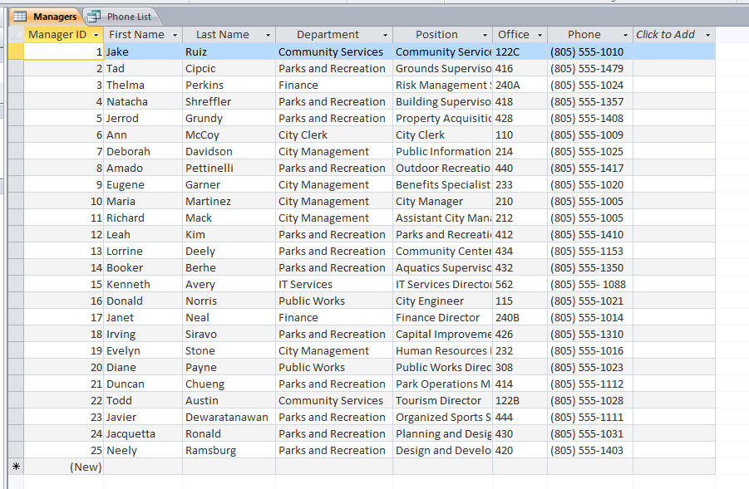
Tables
Tables are the heart of the database.
  Tables are a collection of records (rows) that share the same fields (columns)
One column holds unique information
One record per row

Slide 6

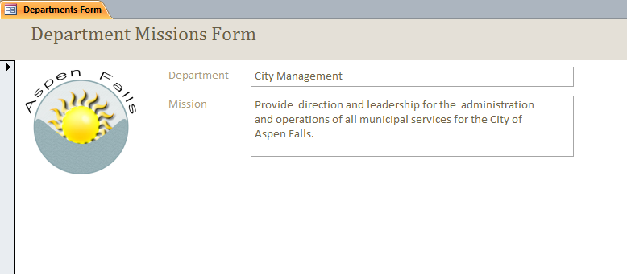
Forms
Shows one record at a time
  Used to edit or enter data
Shows only one record/row

Slide 7
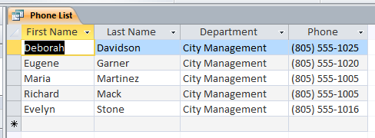
Queries
A query asks a “question” of the database
  Used to sort and search records
  It looks like a table but instead it takes some information from a table (or another query)
Looks like a table

Slide 8
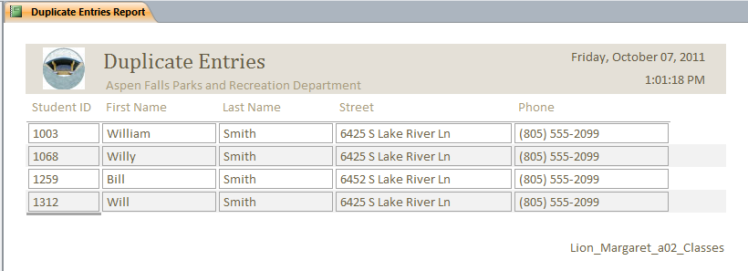
Reports
Reports are summaries of data used for printing/presenting data
  Reports show data from tables or queries

Slide 9
Special Thanks To:
Pat Setser
Lowell Furman

