Slide 1
Introduction to Website Creation in sphb K200
School of Public Health-Bloomington
By Margaret Lion, senior Lecturer, Dept. of Kinesiology

Slide 2
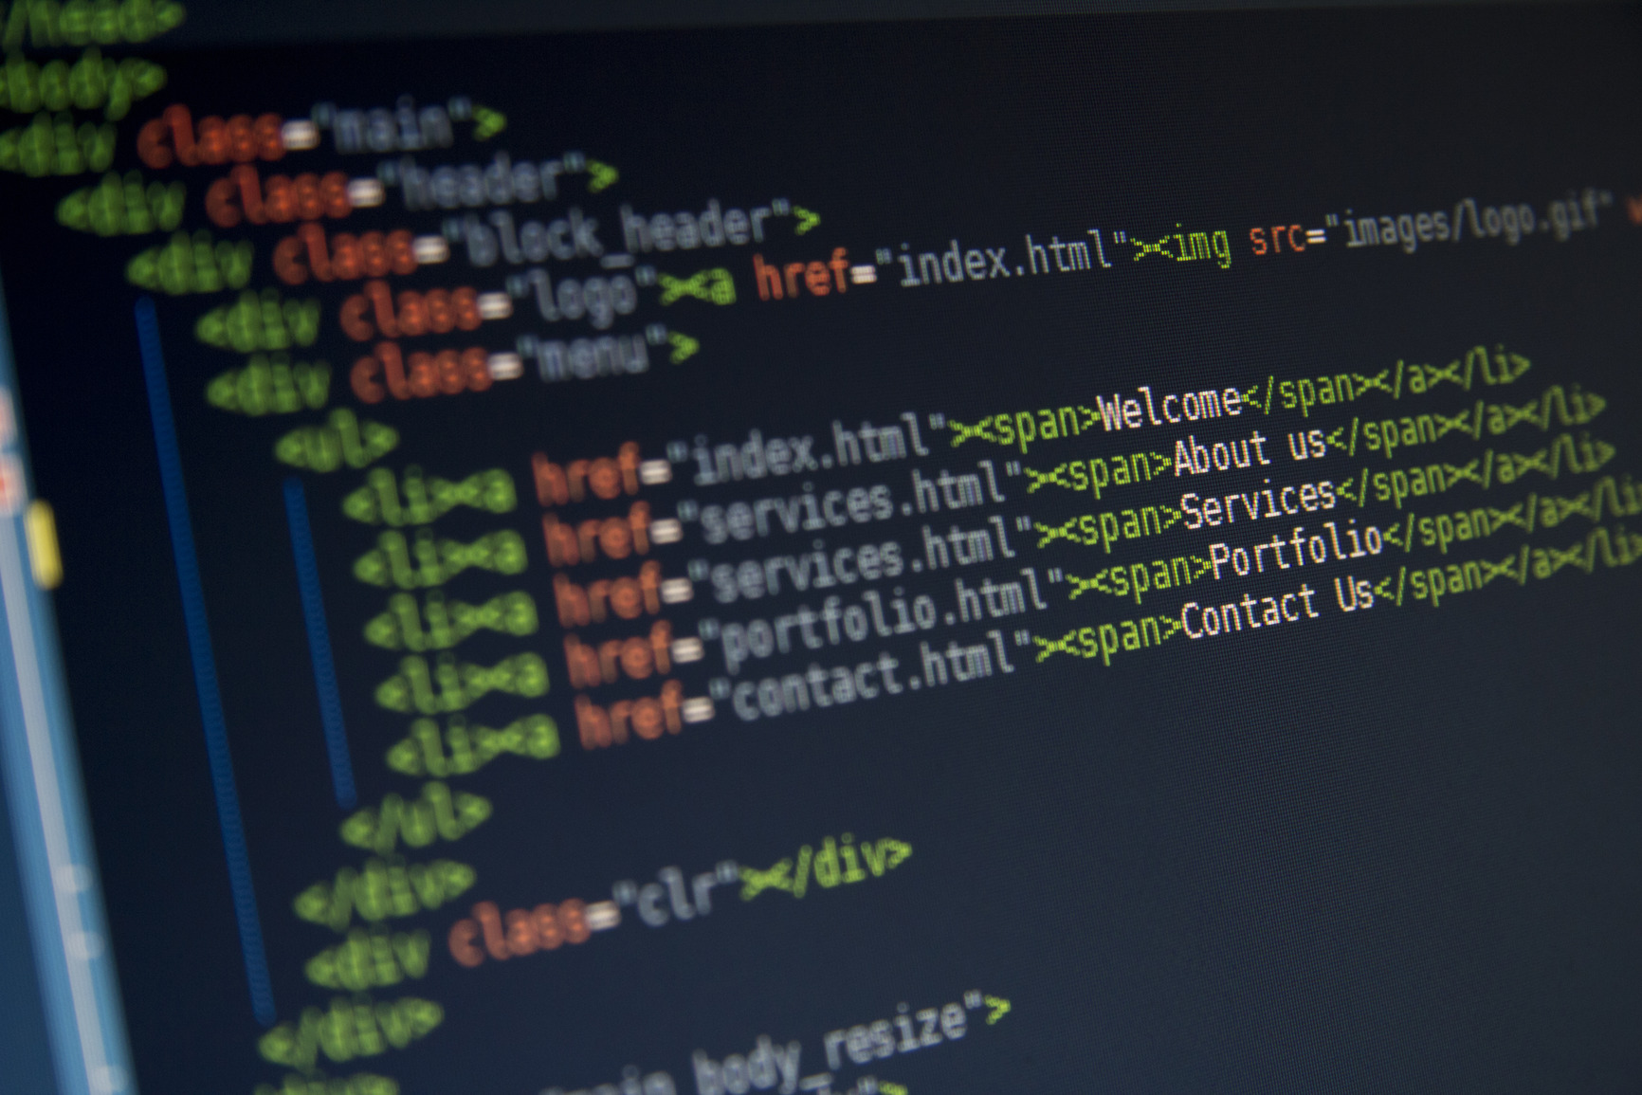
What is a Website?
Websites are code. Most common codes are:
HTML - for Hyper Text Markup Language
CSS – Cascading Style Sheets
JavaScript
PHP
Java

Slide 3
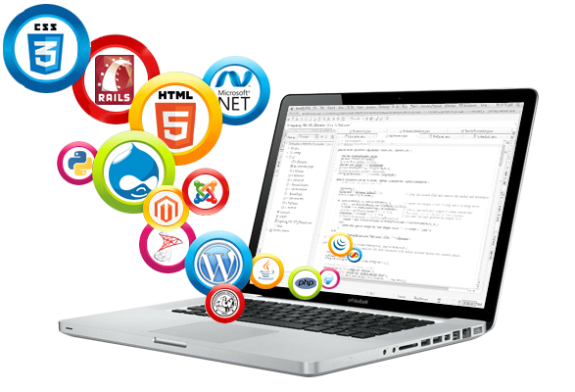
Methods of website creation
Content Management System (CMS)
Specific Software (Dreamweaver)
Hand Code (Notepad & Website Languages)

Slide 4
Method for k200 - CMS
Weebly.com is a CMS
Easy to use
Rated highly by industry
Found at Weebly.com

