Slide 1
Technology ONION – SOFTWARE
Sources: Patricia Setser
Revised by Margaret Lion 2018©
and GO! Microsoft Office 2007 Brief

Slide 2
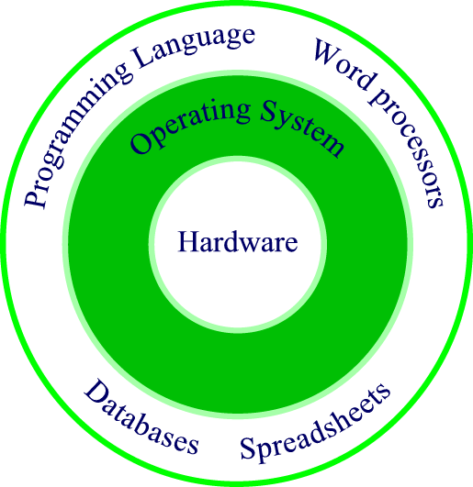
Relationship of OS to hardware and software
ONION ANALOGY
Notes:
The OS is the go-between for the hardware and the programs and data: it is the grunt soldier. When a program (the Army’s general officer) issues a command to write to or read from a device, the OS does its soldierly duty and implements the instruction. The OS forms a common interface for all programs for the specifics of loading a program to memory, writing to a disk, moving the read/write disk head, spinning the disk platter, and so on. Some of the most popular operating systems currently in use include Windows Vista, and UNIX, LINUX.

Slide 3
Application Software…Interfaces with the USER
It helps you accomplish tasks:
  Creating letters
  Performing financial analysis
  Preparing presentations
  Staying organized
  Running your business

Slide 4
TYPES of Application Software
  Personal Productivity
    Word Processing (WordStar one of the first, WordPerfect, MS Word)
    Spreadsheet (VisiCalc one of the first, Lotus 1,2,3, MS Excel)
    Presentation (Corel Draw, MS PowerPoint)

Slide 5
TYPES of Application Software (Con’t.)
    Most software manufacturers group applications together into a package called a suite
    The cost of a suite is usually less than the total cost of purchasing each of the applications individually

Slide 6
TYPES of Application Software (Con’t.)
    Example Suite:
      Microsoft Office 2016:
        Word
        Excel
        Access
        PowerPoint

Slide 7
TYPES of Application Software (Con’t)
  Statistical Analysis (SAS, SPSS)
  Web Browser (Mozilla Firefox, Chrome, Microsoft Edge)
  Sound Editor (Audacity)
  Website Creation (Weebly.com)
  GAMES!!! (Solitaire, Diablo 1-3, Doom 3)

Slide 8
Software Extensions
Every piece of software has its own file extension, letters that appear at the end of the file name. Computers use these extensions to identify which program to use.
For example:
  Word: .docx
  Excel: .xlsx
  Access: accdb
  PowerPoint: .pptx
  Webpages: .html or .htm

Slide 9
SPECIALIZED Application Software (by Industry or Function)
  You might use Microsoft Publisher or Adobe Illustrator to create a newsletter or brochure
  Bookkeepers rely on special accounting packages such as Peachtree Accounting or QuickBooks to balance the books and handle other accounting functions
  Graphic designers turn to packages like Adobe Photoshop or Adobe Illustrator to develop creative artwork

Slide 10
SPECIALIZED Application Software (by Industry or Function)
Sound Engineering - Audacity
  www.audacityteam.org/
Website Creation – Weebly
  www.weebly.com
Gaming – Diablo III
  https://us.battle.net/d3/en/

