Slide 1
Technological ONION
Computer Systems – Hardware, Operating System, & Software
Sources: Patricia Setser
Modified: Margaret Lion

Slide 2
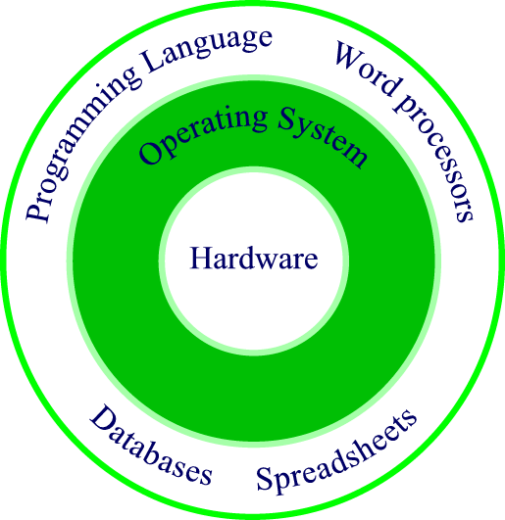
Hardware, operating systems, and software onion analogy.
Notes:
The OS is the go-between for the hardware and the programs and data: it is the grunt soldier. When a program (the Army’s general officer) issues a command to write to or read from a device, the OS does its soldierly duty and implements the instruction. The OS forms a common interface for all programs for the specifics of loading a program to memory, writing to a disk, moving the read/write disk head, spinning the disk platter, and so on. Some of the most popular operating systems currently in use include Windows, Windows NT, and UNIX. Visual Basic is a development tool which writes programs for Windows-based operating systems.

Slide 3
Computer Hardware - Onion
Hardware is the center of the computer system

Slide 4
Computer Hardware
Hardware is the computer and any equipment connected to it
Hardware devices are the physical components of the computer
Items such as the monitor, keyboard, mouse, and printer are also known as peripherals because they attach to the computer
Something you can touch.
Comparison: Hardware is your body.

Slide 5
Computer Hardware - Functions
Information processing cycle of a computer
  Input – Computer gathers data or allows a user to add data
  Processing – Data is converted into information
  Output – Data or information is retrieved from the computer
  Storage – Data or information is stored for future use

Slide 6
Operating System (OS) – Technology Onion
OS is the second layer of the computer system

Slide 7
Operating System
Functions of Operating System (OS):
Controls look of computer.
Controls how computer operates.
Controls what software can be installed and run on computer.
Comparison: OS is your autonomic system.

Slide 8
Operating System - Types
Major Types of Operating Systems:
  Windows
  Mac OS
  Linux

Slide 9
Software – Technology Onion
Software is the third layer of the computer system

Slide 10
Software - Functions
Software Functions:
  Software performs specific tasks.
  Software can only open files created by it or files that it has been created to open and edit.
  Comparison: Software is a skill you can perform, like riding a bike. You couldn’t ride the bike without your body (hardware) or a working autonomic system (OS).

